Slide 1

CHANGE YOUR MINDSET
CHANGE YOUR RESULTS
How thinking a little differently can make a BIG difference in finding your right next career role.
Jeff Wuenker, Director of Career Happiness Coaching. The Bauke Group
Jennifer Schroer, Senior Manager Organizational Development, CTI

Slide 2




THE BAUKE GROUP
THE BAUKE GROUP is in the business of Career Happiness
  We work with professionals on all aspects of careers; planning, strategy, management, transition, and navigation.
  Anything related to careers we coach, teach, talk about and train, and have been collectively for over 50 years.
  Whatever the situation or need, it’s always about helping people find Career Happiness.

Slide 3





THE BAUKE GROUP
PROCESS
CLARIFY WHO YOU ARE AND WHAT YOU WANT
STRATEGIZE AND ORGANIZE
GO AFTER THE RIGHT JOB IN THE RIGHT WAY
THINK
PLAN
EXECUTE

Slide 4





THINK-MINDSET SHIFT
REVERSE YOUR MINDSET, REVERSE YOUR APPROACH:
  LOOK FOR THE JOB THAT FITS YOU.
DON’T BELIEVE THE WIDEST NET CATCHES THE MOST FISH
THE WRONG JOB ISN’T THE RIGHT ANSWER.
GIVE YOURSELF PERMISSION TO SHOOT FOR THE STARS.

Slide 5
CAREER HAPPINESS FORMULA
WHAT YOU LIKE/LOVE TO DO.
WHAT YOU DO WELL.
WHAT YOU CAN GET PAID FOR APPROPRIATELY.
IN AN ENVIRONMENT WHERE YOU ARE VALUED AND CAN BE SUCCESSFUL.

Slide 6

PLAN-MINDSET SHIFT
TREAT YOUR CAREER WITH THE SAME PLANNING MINDSET YOU DO WITH EVERYTHING ELSE IN YOUR LIFE.
BE STRATEGIC… THINK LIKE A MARKETER.
INCORPORATE YOUR THINK INTO YOUR YOUR STRATEGY AND PLAN.
WE’RE ALL PROJECT MANAGERS.

Slide 7

EXECUTE - MINDSET SHIFT
RE-PHRASE OR RE-DEFINE “NETWORKING”.
GET OKAY WITH THE IDEA OF GETTING HELP.
THINK ABOUT NETWORKING OR INTERVIEWING AS CONSULTATIONS, NOT AUDITIONS.
DON’T THINK ABOUT IT AS SELLING YOURSELF.
BE COMFORTABLE AND CONFIDENT IN BEING YOURSELF.
PERMIT YOURSELF TO ENJOY SOME OF THIS TIME.
Notes:
Tell me about yourself
(first interview question or what others are seeking in a meeting/connection)
Always have it ready and current
How do you want to present yourself
You get to decide

Slide 8



THE PAYOFF
Where proper Thinking, Planning, & Execution
meets Opportunity
OFFERS
INTERVIEWS
RECRUIT, SEARCH FIRM ENGAGED, REFERRALS, POST
JOB DESCRIPTION CREATED
A NEED IS FELT
PAIN POINT

Slide 9

CHANGE YOUR MINDSET, CHANGE YOUR RESULTS
THINK DIFFERENTY
PLAN DIFFERENTLY
EXECUTE DIFFERENTLY

Slide 10

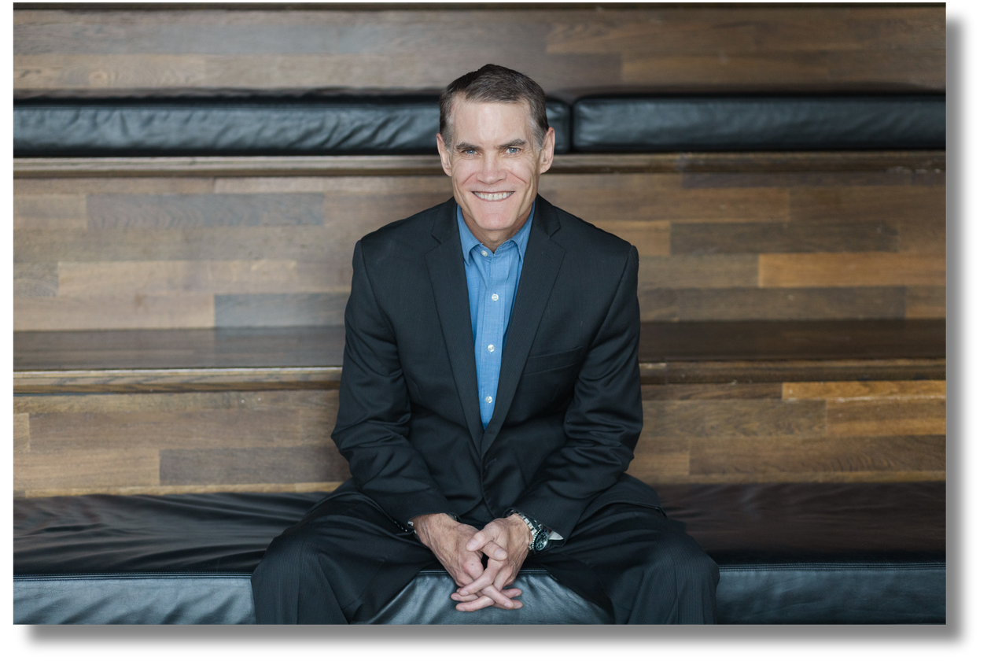

THANK YOU
JEFF WUENKER
DIRECTOR OF CAREER HAPPINESS COACHING
JW@THEBAUKEGROUP.COM
513.324.9773

