Slide 1
Second Launch

Slide 2
Ground Rules
Today is a discussion. You can ask anything.

Slide 3
About Me
30 -year retail executive seeking my ‘second act’ first time in transition
non-degreed don’t know what I don’t know
jobs have always come to me
My career will end in may 2017.

Slide 4
What I do know…
no more retail… ever passionate about HR successful team builder

Slide 5
STRENGTHS | WEAKNESSES
Highly experienced strategic leader Team Builder Culture Change Agent Skilled in Employee Relations Knowledgeable in HR Growth Mindset | HR Experience too old I’m too old! No College Degree No Industry Experience No Network Not sure how to look for a job in today’s world
OPPORTUNITIES | THREATS
HR roles are indemand Strong economy | Market expects MBA and direct experience at my desired level Target industries want significant union experience

Slide 6
What’s next for me
seeking senior level HR role expect up to a year key industries manufacturing, logistics what differentiates me how I will get there

Slide 7
Enough about me…

Slide 8
Blueprint for success
Assess and update your skills
Define your goal
Hone your message
Develop your search plan

Slide 9
Networking
The ability to network is crucial to your success.

Slide 10
Stay engaged with your family
They’re going through this with you and want to help you succeed.

Slide 11
Find an accountability partner

Slide 12
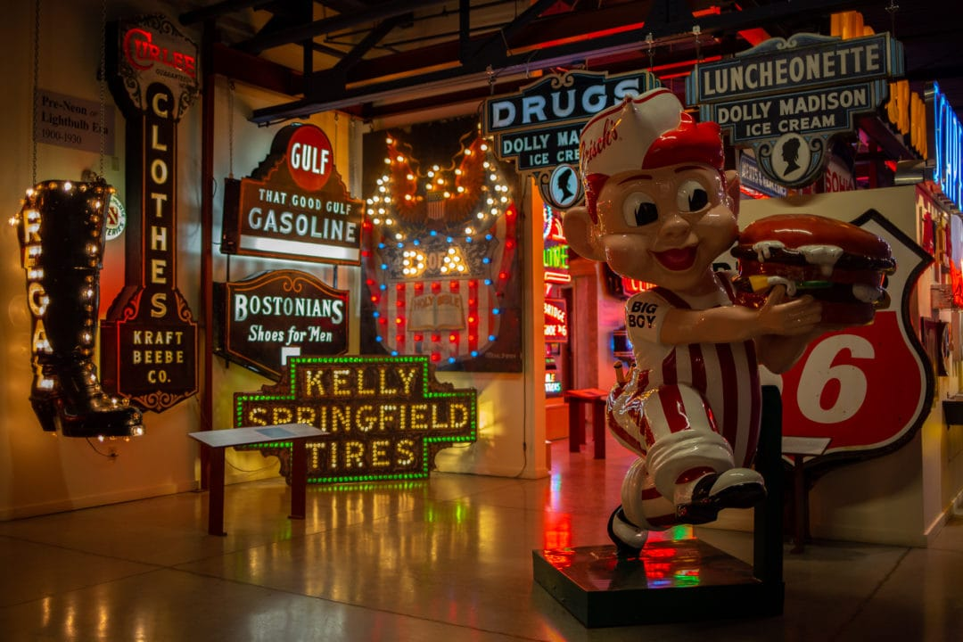
Make time for you…

Slide 13
What’s Next

Slide 14
Thank You

